Slide 1
BREAST CANCER PREDICTION
USING MACHINE LEARNING
Project Supervisor:
Sangeeta Arora
Team Members:
Bharti Ghildiyal
Diksha Gupta
Anupam Gupta
Ayush Gupta

Slide 2
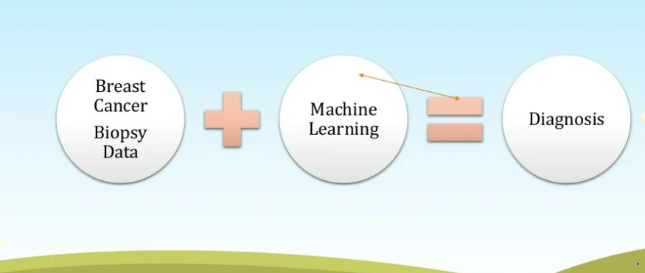
INTRODUCTION
WHAT IS MACHINE LEARNING?
Machine learning (ML) is defined as a discipline of artificial intelligence (AI) that provides machines the ability to automatically learn from data and past experiences to identify patterns and make predictions with minimal human intervention.

Slide 3
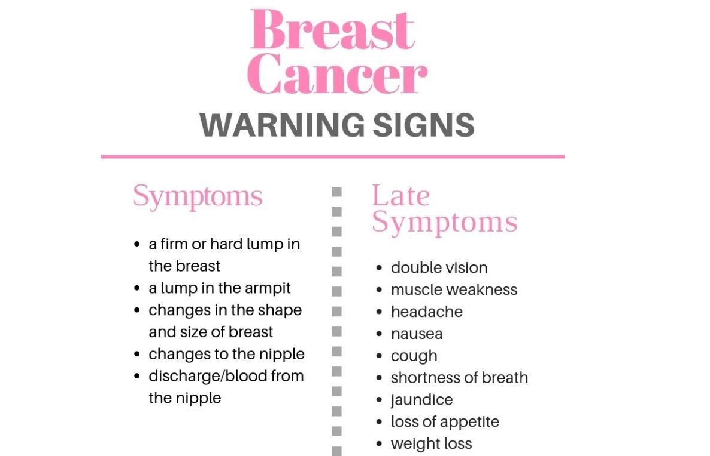
BREAST CANCER-OVERVIEW
Breast cancer is the second leading cause of cancer death in women.
This cancer starts with uncontrolled and fast multiplication of breast tissues which are classified as benign and malignant. Benign are just abnormality present in breast tissues but may not cause death to the patient on the other side malignant is type of tumor tissues their timely diagnosis can increase the mortality rate.
Men do not get breast cancer, it affects women only-MYTH.

Slide 4
SOFTWARE REQUIREMENTS
Operating system: Windows 10
Anacoda with Python3
Jupyter Notebook
Library used:NumPy,Pandas,SkLearn
Framework: Flask

Slide 5
HARDWARE REQUIREMENTS
Processor: i3 or above
RAM: 4GB or above
Hard Disk: 500GB or above

Slide 6
MODULES
There are two modules in this project--
1. User login 2.Machine learning model
1.User login -
In this module user will be able to register to access the website then login page is shown which allows user to
Gain access to website by entering their username and password.
If authentication is successful then the user is directed to the first web page .otherwise the user remains on the login page.

Slide 7
2. Machine learning model -
In this module we will upload the Dataset file will be of excel type , in this dataset there will be n number of record which will used to analyze the breast cancer of the user .
User will interact in this module by filling the following details; Texture mean, Area mean, Concavity mean, Area ,SE, Concavity SE, Fractal dimension SE, Smoothness worst, Concavity worst, Symmetry worst, Fractal dimension worst after filling all these parameters user will be able to predict or analyse about the cancer by clicking on the analyse button .

Slide 8
OUTPUT
Prediction : Whether the patient is having Malignant or benign cancer.
Probability: The chances of tumor is cancerous or not.
If the probability is more than 50%,the tumor is malignant and if the probability is less than 50%, it is benign.
Calculation of accuracy

Slide 9
CONCLUSION
A decision support system for predicting breast cancer helps and assist physicians in making optimum,accurate and timely decision and reduce the overall cost of treatment.
KNN classifier has been used as it yields the highest classification accuracies.
The system greatly reduces the cost of treatment and improves the quality of life by predicting breast cancer at early stage.

Slide 10
HOW TO SERVE SOCIETY
In India, the incidence of cancer is increasing rapidly; therefore it is important to step up cancer literacy and knowledge amongst the population.
We hope that this will lead to early detection which is important in the management and treatment of cancer and also prevention by making necessary changes in lifestyle.
Breast Cancer is rapidly rising amongst women in urban areas and it is the most common cancer in India. Early detection is essential in its management and treatment. Due to ignorance, fear, and social stigma many women present with stage III or IV cancer which requires surgery and extensive treatment.

Slide 11
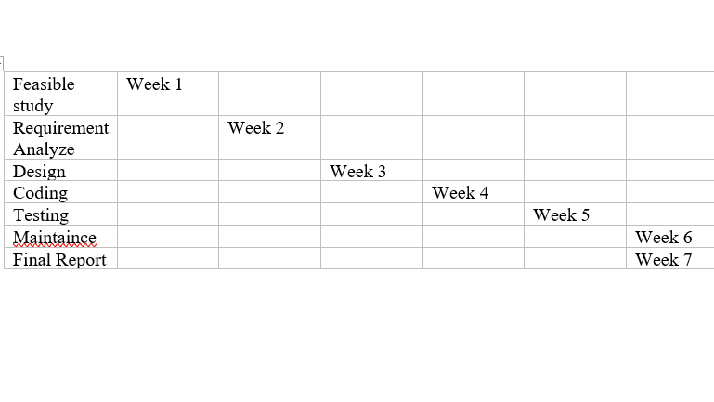
GANTT CHART

